Slide 1

Mind Metrics
Detecting Depression, Anxiety, and Stress in Students via Machine Learning
Bhaskar Pal (230020741126)
Shreyash Mulate (230020199279)
Debprasad Manna (230020216672)
Debanjan Bhattacharya (230020852095)
Sudip Kumar Patra (230020236253)
Under the supervision of
Dr. Rana Majumdar
Professor
Department of Computer Science
Sister Nivedita University
30-04-2025

Slide 2
Introduction
Brief Overview:
Mind Metrics is a machine learning-based system designed to enable early
detection of depression, anxiety, and stress in students by analyzing self-reported survey data. Leveraging ensemble models—especially AdaBoost—it delivers early, accurate predictions that enable timely mental health intervention.
Motivation:
Rising mental health issues among students.(Fig 1.1: DALYs burden).
Academic pressure, social expectations, and personal challenges.
Limitations of traditional methods (subjective, time-consuming).
Early detection enables timely intervention.
Problem Statement:
Traditional assessments: slow, subjective, often underreported.
Gap: Need for efficient, objective, and scalable mental health screening.

Slide 3
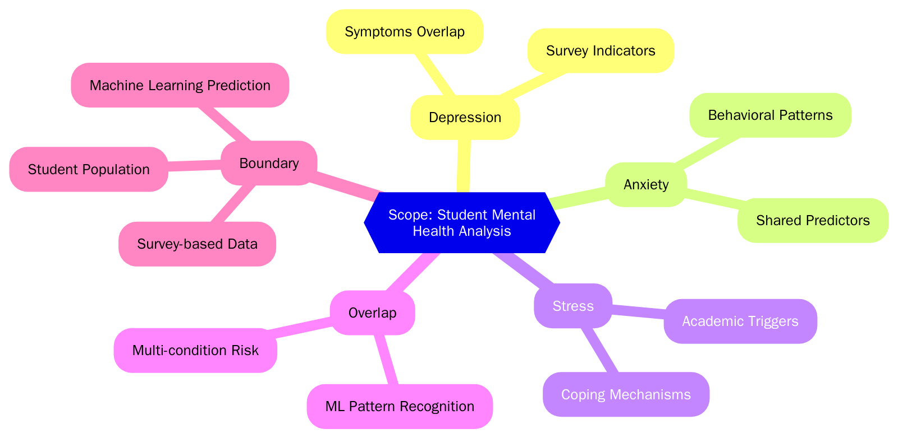
Objectives
Primary Objective:
— Develop a machine learning system for multi-label prediction of students' depression, anxiety, and stress.
Secondary Objectives:
— Analyze and preprocess student mental health data.
— Compare classical and ensemble machine learning models.
— Identify the most effective predictive approach.

Slide 4
Literature Review
Summary of existing solutions or related work:
Study | Approach/Tools | Key Result
Longitudinal Study (2021) | Surveys, ML | Correlation with academics
Learning Stress Study (2022) | Statistical analysis | Stress impacts performance
ML for Student Mental Health (2015) | ML models | Early risk identification
Identified Gaps:
— Limited use of ensemble ML methods.
— Lack of objective, scalable tools for early detection.
— Underreporting due to stigma.

Slide 5
Proposed System
Key Components:
— Survey Data: Student self-reports.
— Preprocessing: Cleaning(Handle missing values), normalization(Label Encoding).
— Feature Extraction: Key features selection and extraction(SelectKBest).
— Multi-output ML Models: Classical & ensemble.
— Output: Prediction(Depression, Anxiety, Stress).
Identified Gaps:
— Limited use of ensemble ML methods.
— Lack of objective, scalable tools for early detection.
— Underreporting due to stigma.

Slide 6
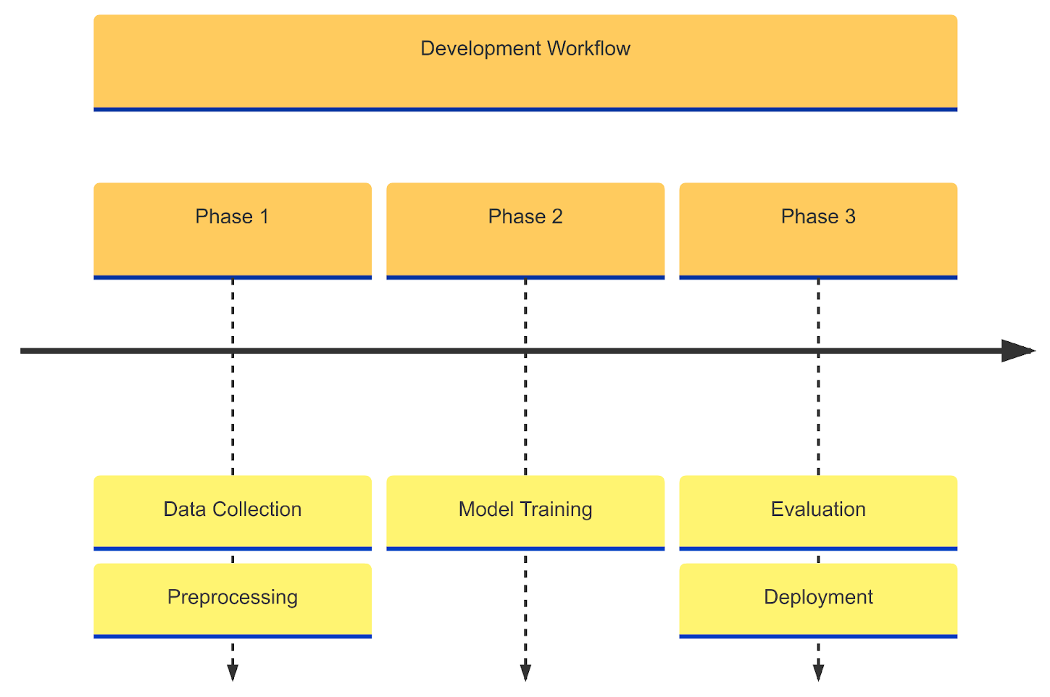
Implementation
Stages of development:

Slide 7
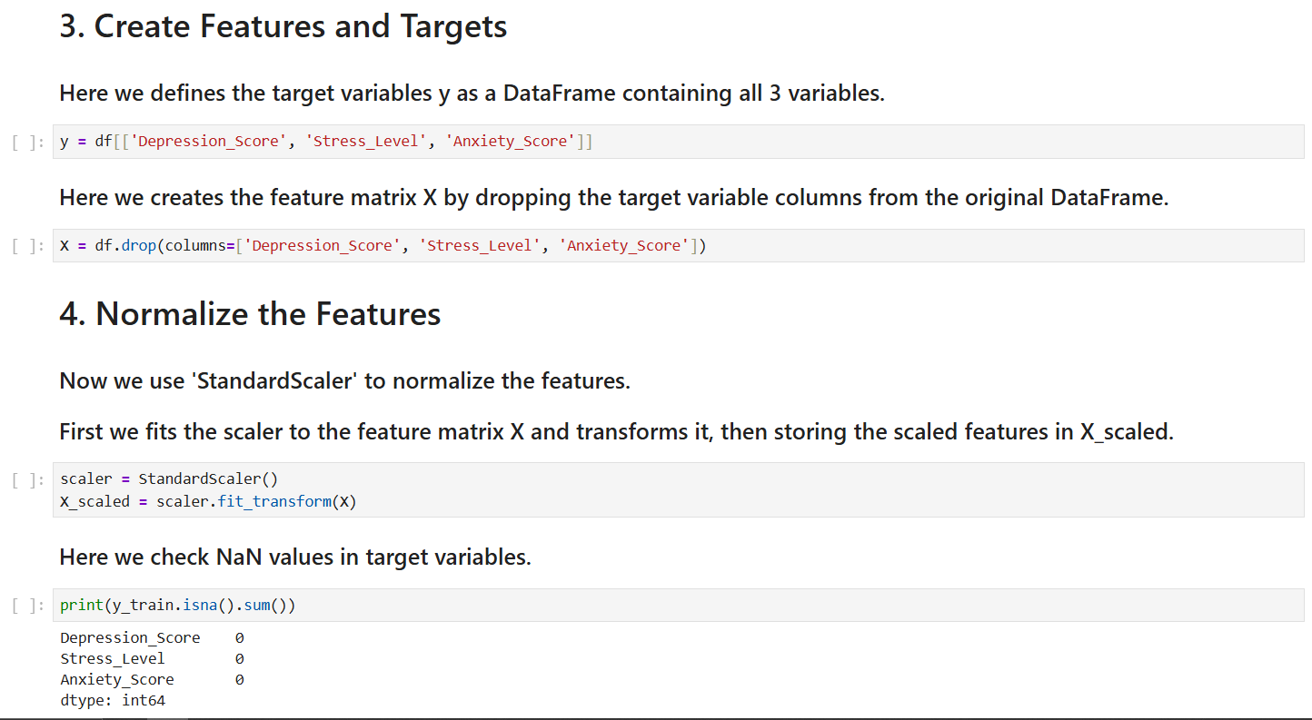
Screenshots/code snippets

Slide 8
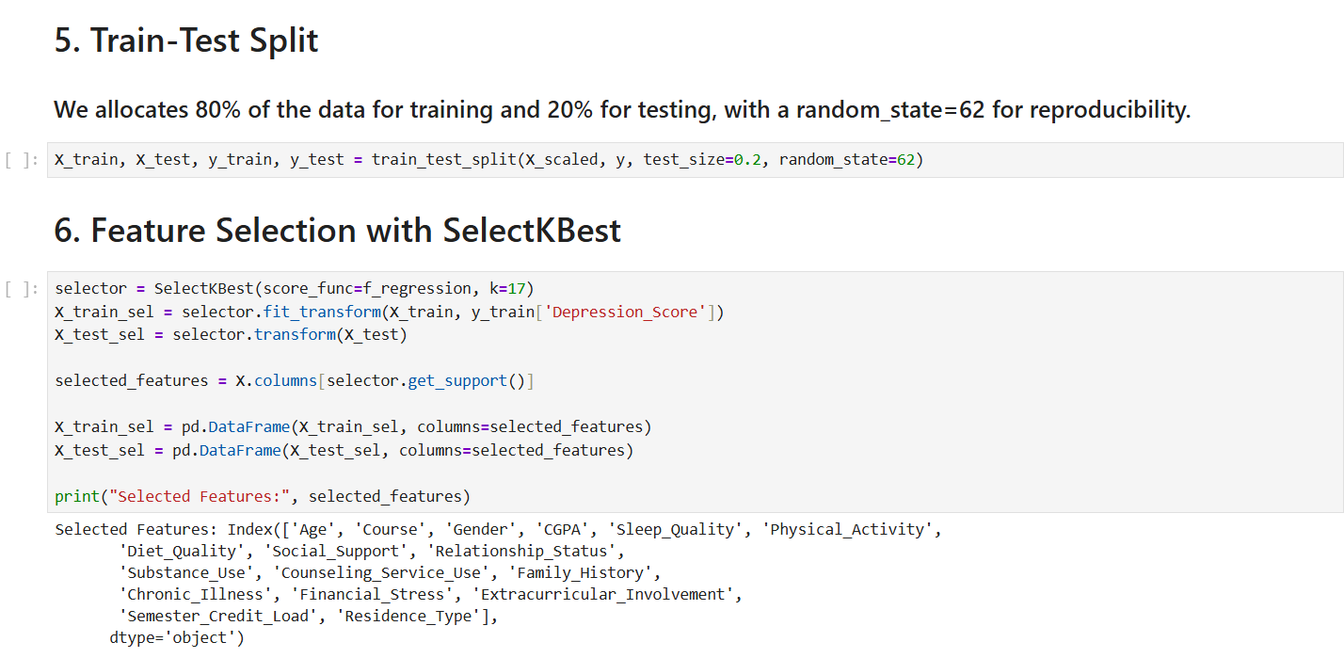
Screenshots/code snippets

Slide 9
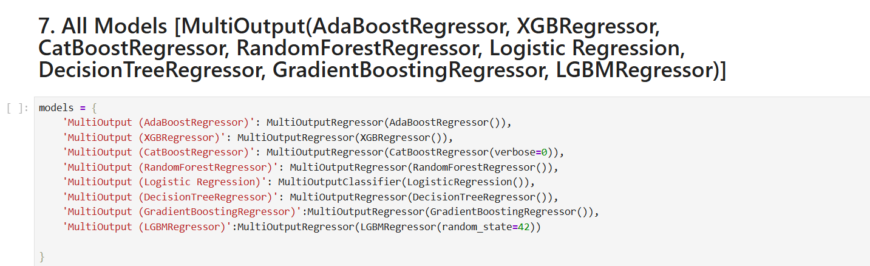
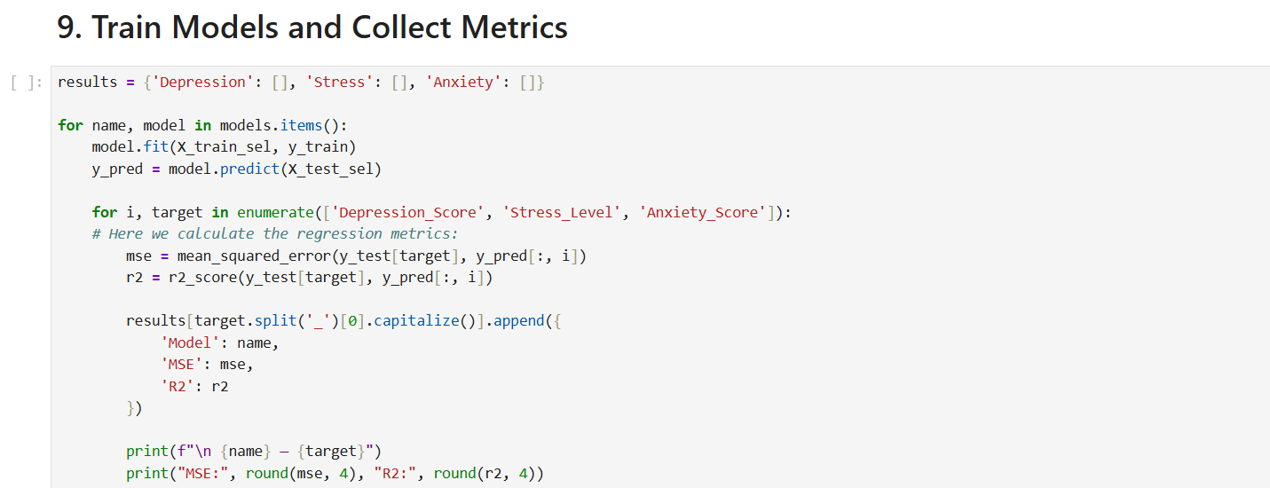
Screenshots/code snippets

Slide 10
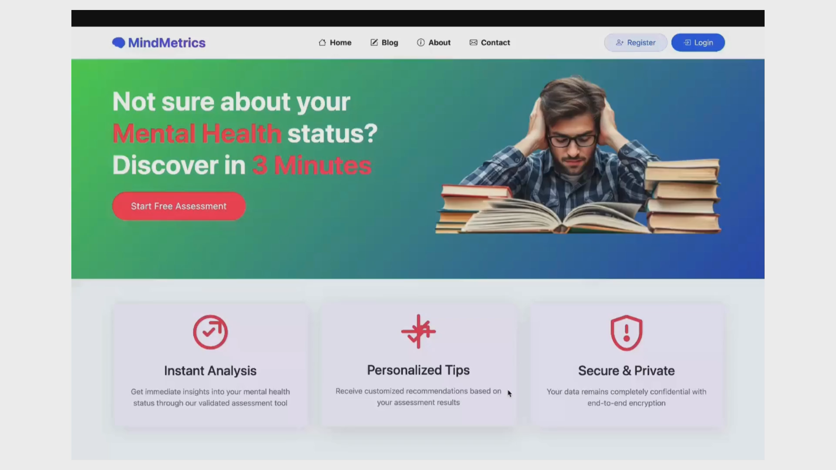
Demo video reference

Slide 11
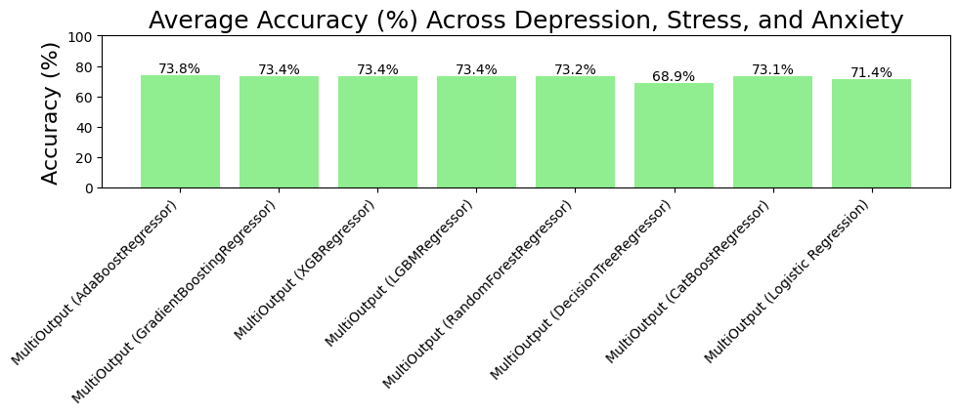
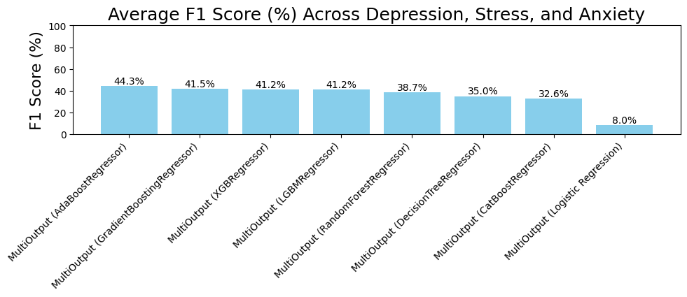
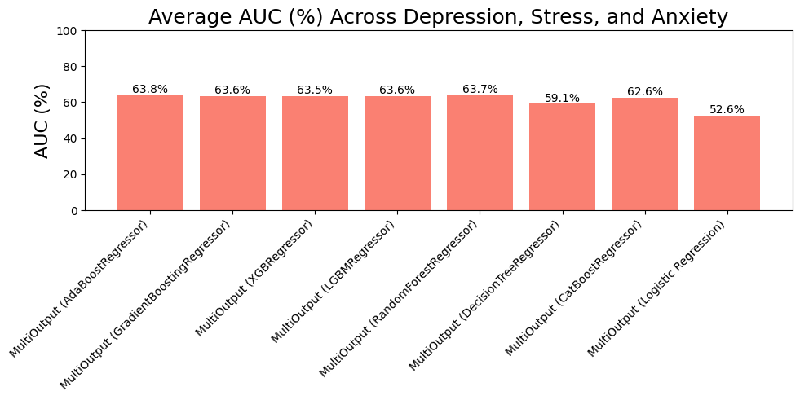
Results

Slide 12
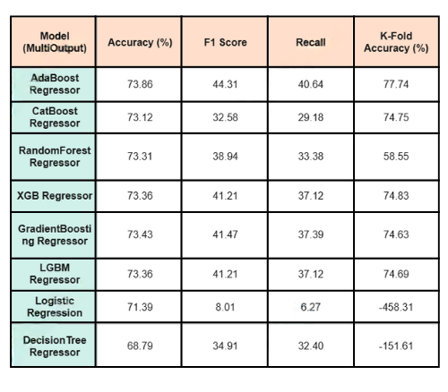
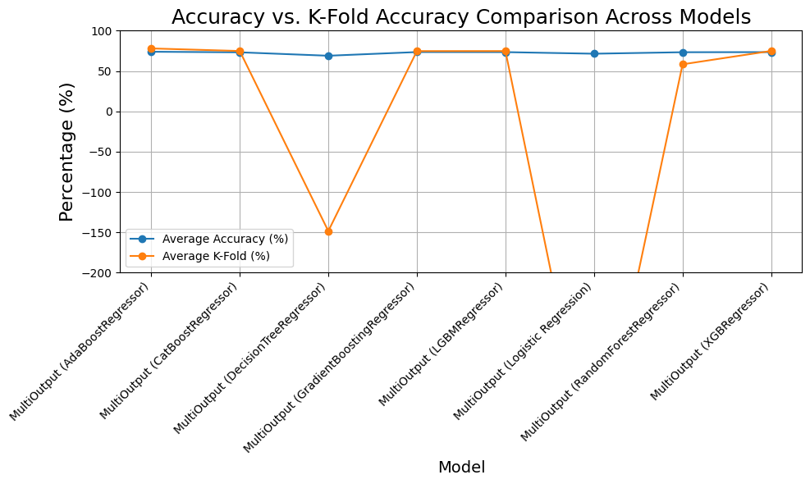
Results / Output
Performance metrics or validation:

Slide 13
Challenges Faced
Technical Challenges | Non-Technical Challenges
Data imbalance | Data privacy concerns
Model overfitting | Stigma in self-reporting
Feature selection | Survey participation
Solutions:
— Used ensemble models to address imbalance.
— Ensured anonymized data collection.
— Use neutral, supportive language to frame discussions.
— Educate communities to challenge biases and misconceptions.

Slide 14
Conclusion & Future Work
Outcomes:
— Developed a robust ML-based detection system.
— AdaBoost outperformed other models.
— Validated on real-world student data.
Limitations:
— Dependent on self-reported data.
— Small dataset size.
— Moderate F1-scores and Average Accuracy indicate room for improvement.
Future Enhancements:
— Integrate real-time data sources (e.g., mobile app).
— Expand to other demographics and educational institutions.
— Incorporate feedback mechanisms for continuous improvement.
References:
— Dataset: Students Mental Health Assessments Dataset, Kaggle.

Slide 15
References
References
Serial No | Resource Type | Source | Title | Key Result
1 | Article | WHO | Depressive Disorder | 1. Effective treatments exist (therapy/meds) 2. Exercise prevents depression (older adults)
2 | Article | WHO | Anxiety Disorders | 1. Women more affected 2. Stigma prevents treatment
3 | Report | Lancet | Global Mental Health | 1. Community care effective 2. Prevention strategies needed
4 | Report | Lancet Commission | Global Mental Health and Sustainable Development | 1. Mental disorders rising globally 2. Treatment gap persists in low-income countries
5 | Longitudinal Research | JAMA Psychiatry | Long-term Outcomes in Depression | 1. Early intervention reduces relapse 2. Medication adherence critical for recovery

Slide 16
Acknowledgement
We express sincere gratitude to all contributors who made this project possible:
Core Mentorship:
— Dr. Rana Majumdar for expert guidance, technical insights, and unwavering mentorship throughout the development process.
— Faculty members of Department of Computer Science for their academic support and resource access.
Collaborative Support:
— Peer reviewers for constructive feedback on model optimization and documentation.
— Technical staff for assistance with computational resources and tools.
Personal Encouragement:
— Friends and family for their patience, motivation, and emotional support during challenging phases.
— Classmates for brainstorming sessions and collaborative problem-solving.
Institutional Backing:
— Sister Nivedita University for providing the infrastructure and research ecosystem.
— Kaggle community for open-access mental health datasets.

Slide 17
Thank you!

